Slide 1


Final IPR
Air Force ROTC Detachment 842
The University of Texas at San Antonio
C/2d Lt Frankie Rodriguez & C/1st Lt Joanna Finley
09 May 23

Slide 2


Overview
Event Roles
Script
Venue Information
DVs
Series of Events
Volunteer Info
Equipment Needed
Air Force ROTC Detachment 842 • We Build Exceptional Officers • The University of Texas at San Antonio

Slide 3
Event Roles

Slide 4
Event Roles
Program Label: May 10th
MC: C/Camelo
Volunteer Team Lead: C/Burns
National Anthem: Jessica Brucks
Cake: Betzel, Atkinson, Silva
Pictures/Livestream: C/Rodriguez, C/Eggers, C/Burns, C/Rocha
Honor guard: Irizarry, Pacheco, Schrecker, Davidson, Scott, Fulk
Air Force ROTC Detachment 842 • We Build Exceptional Officers • The University of Texas at San Antonio

Slide 5
Script

Slide 6
Script
https://docs.google.com/document/d/1WEbt67J4fBQfoCCdmTNiYKTEXxaAJE1MXdln0bHt61s/edit?usp=sharing
Air Force ROTC Detachment 842 • We Build Exceptional Officers • The University of Texas at San Antonio

Slide 7
Venue Information

Slide 8
Venue Information
1020 Tinker Ave
LACKLAND AFB
Handicap Parking available if needed
Air Force ROTC Detachment 842 • We Build Exceptional Officers • The University of Texas at San Antonio

Slide 9
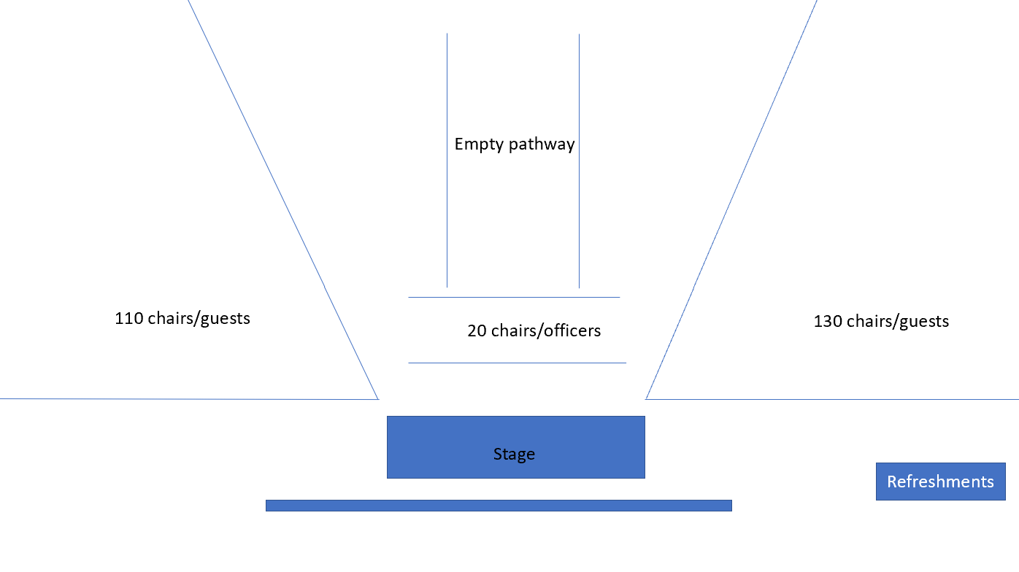
Venue Information
Air Force ROTC Detachment 842 • We Build Exceptional Officers • The University of Texas at San Antonio

Slide 10
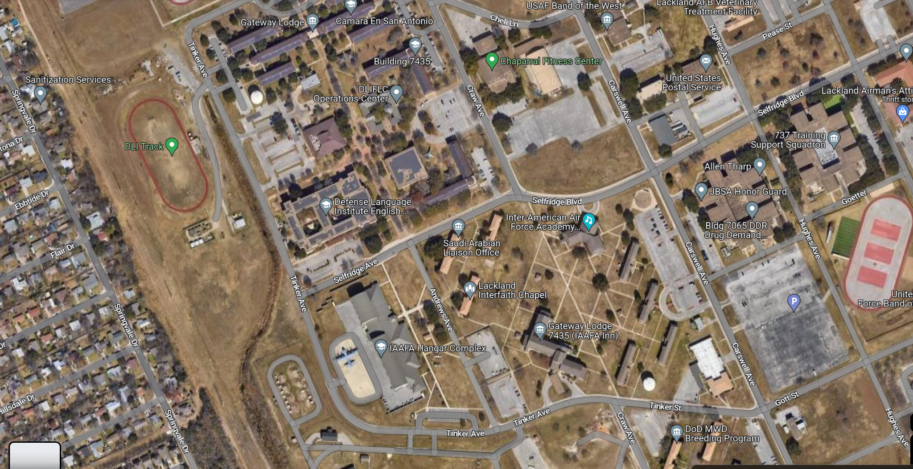
Venue Information
Air Force ROTC Detachment 842 • We Build Exceptional Officers • The University of Texas at San Antonio

Slide 11
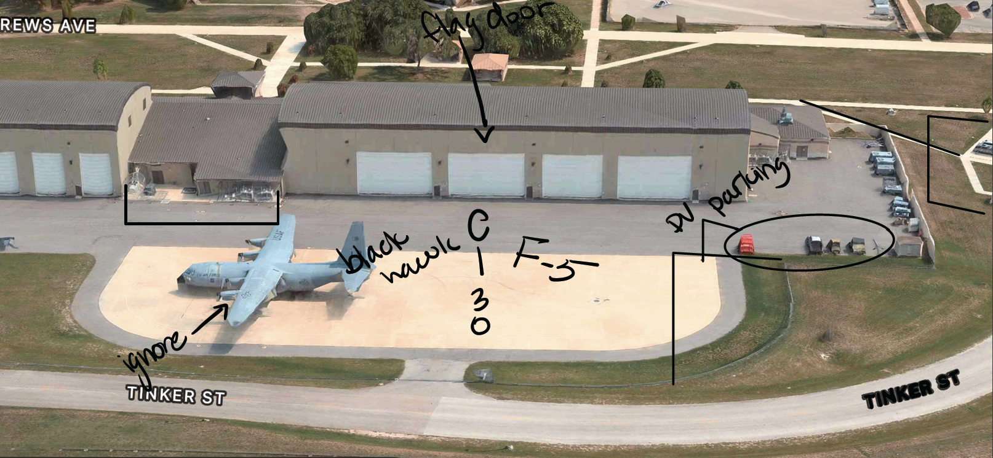
Venue Information
Air Force ROTC Detachment 842 • We Build Exceptional Officers • The University of Texas at San Antonio

Slide 12
DVs

Slide 13
DVs
Lt Gen Robinson
Mrs. Maureen Robinson
Aide de Camp Capt Rodriguez
IAAFA
Col Jose Jimenez- Commandant Inter American Air Forces Academy
Col Mario Adorno- International Deputy Commandant from the Paraguayan Air Force
Lt Col Kenneth Herringdine- Deputy Commandant
CMSgt Yusuf Saad- Senior Enlisted Leader
Parking
Seating
Air Force ROTC Detachment 842 • We Build Exceptional Officers • The University of Texas at San Antonio

Slide 14
Series of Events

Slide 15
Series of Events
1125-1225: Cadets go up and Pin on 2d LT with first salute
1225-1230: Closing remarks from Lt. Col Hoffman
1230: Air Force Song
1240-1400: Individual Oaths of Office
SIMULTANEOUSLY HAPPENING
1240-1400: Cake and refreshments
1400 End of event
0945 SHOWTIME
1015-1050 Q&A w/ Lt.Gen Robinson
Guest showtime 1030-1045
1100: Ceremony starts
1105-1110: the arrival of the official party with cadets marching in
1110-1115: Posting of the colors and national anthem and invocation
1115-1125: Opening Remarks by Lt Gen Robinson
MASS OATH IS GIVEN
Air Force ROTC Detachment 842 • We Build Exceptional Officers • The University of Texas at San Antonio

Slide 16
Volunteer Info

Slide 17
Volunteer Info
Thursday UOD
DET shirt with black shorts/Black leggings
Friday UOD
Service Dress
OR
Open Collar Blues
Ushers/Guides
May 11th Timeline
List of all volunteers
Air Force ROTC Detachment 842 • We Build Exceptional Officers • The University of Texas at San Antonio

Slide 18
Equipment Needed

Slide 19
Equipment Needed
Det Camera
Fold up Tables X4
HG Flags
Oath Board
Signs for Directions
Air Force ROTC Detachment 842 • We Build Exceptional Officers • The University of Texas at San Antonio

Slide 20
Summary
Event Roles
Script
Venue Information
DVs
Series of Events
Volunteer Info
Equipment Needed
Air Force ROTC Detachment 842 • We Build Exceptional Officers • The University of Texas at San Antonio

Slide 21
Questions?

Slide 22
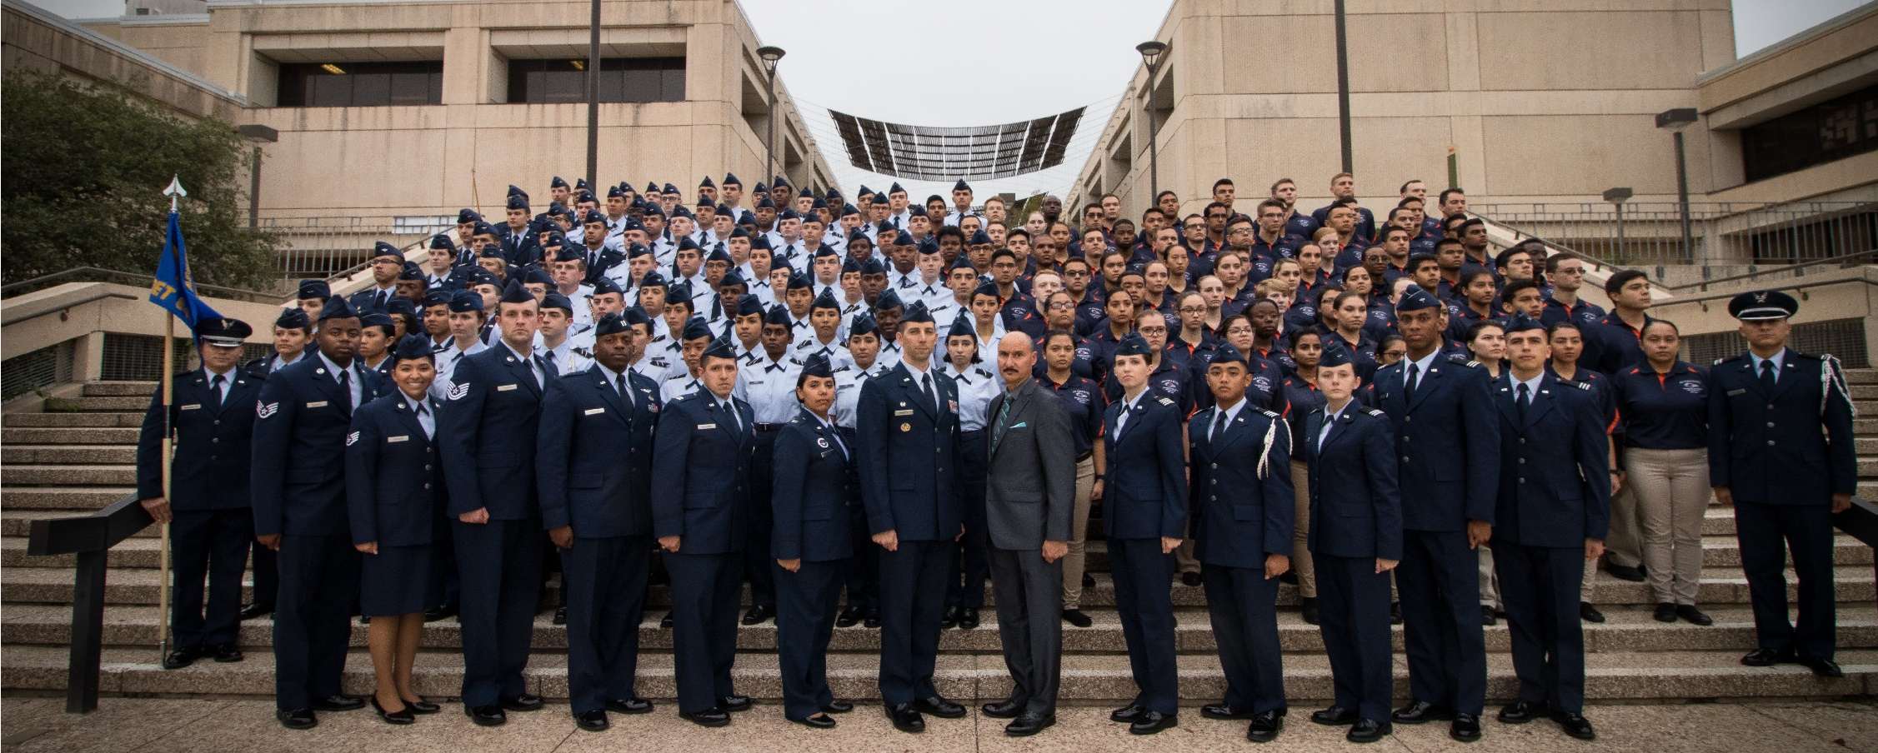
Air Force ROTC Detachment 842
The University of Texas at San Antonio
Det 842 – Best in Blue

